Slide 1
Final Engagement
Attack, Defense & Analysis of the Raven Network
By: Pod 2 Blue Wolf Team: Aniki Fongbemi, Teneisha Franklin & Terrance Houston
Notes:
Thank you for hiring our team to to do an analysis of the Raven Network. This portion of the final engagement will focus on the blue team defensive findings. This portion of the engagement was lead by Aniki, Teneisha and Terrance.

Slide 2
Table of Contents
This document contains the following resources:
Network Topology & Critical Vulnerabilities
Alerts Implemented
Hardening
Implementing Patches
Notes:
The agenda for today is to understand the current operational landscape of the Raven local network. The critical vulnerabilities that are present or that we believe the network could be suspitable to. In addition, we will present our approach to continuous monitoring the network via alerts. Then finally, our recommendations on hardening the network and implementing patches.

Slide 3

Network Topology
& Critical Vulnerabilities
‹#›

Slide 4
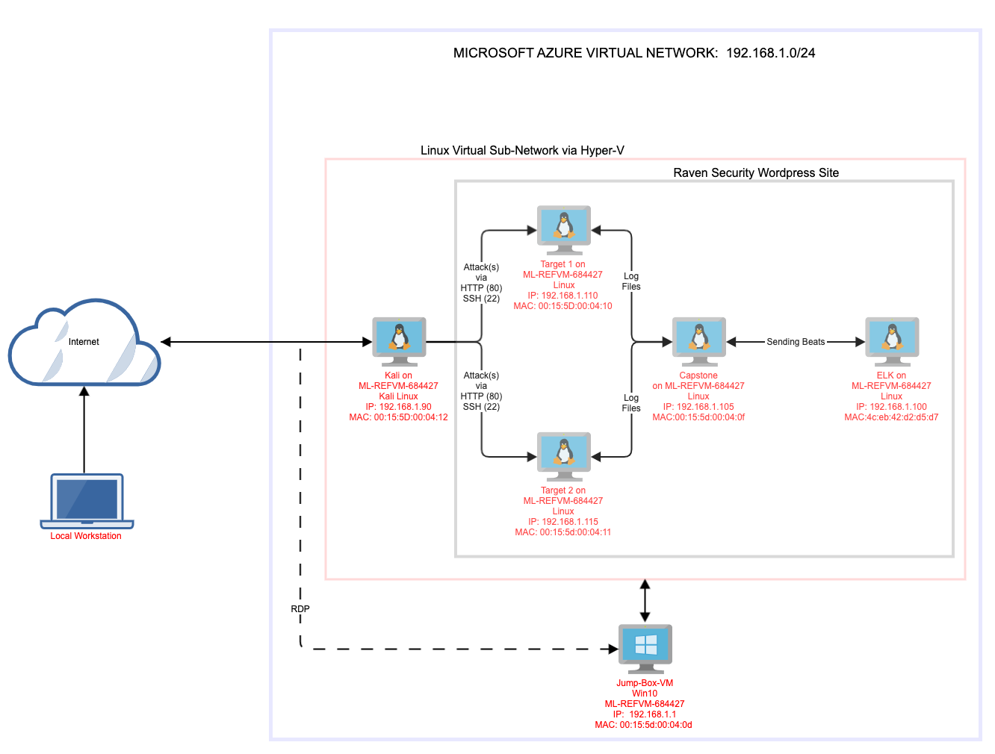
Network Topology
Network
Address Range: 192.168.1.0/24
Netmask: 255.255.255.0
Gateway: 192.168.1.1
Machines
IPv4: 192.168.1.110
OS: Linux 3.2 – 4.9
Hostname: Target 1
IPv4: 192.168.1.115
OS: Linux 3.2 – 4.9
Hostname: Target 2
IPv4: 192.168.1.100
OS: Linux
Hostname: ELK
IPv4: 192.168.1.105
OS: Linux
Hostname: Capstone
Notes:
The raven network represents a typical web application architecture.
We have two front end servers (192.168.1.110 and 192.168.1.115) on our Network (Raven 1 and Raven 2). The purpose of these servers are to display raven security websites and style them in readable formats. They are also responsible for receiving and responding to HTTP requests.
We have one backend server (192.168.1.105) which is called our Capstone Box. The purpose of this server is to executes business logic and read/write corresponding data to and from a database. In this case it is specifically collecting “Beats” which are special-purpose data collection modules. that allow us to only collect very specific information rather than collecting all a machine's log data.
Filebeat collects data about the file system (very specific files, such as those generated by Apache and MySQL databases). it must be installed on the VMs you want to monitor.
Metricbeat collects machine metrics, such as uptime.
Note *ELK officially supports eight Beats*
We have one database server (192.168.1.100) which is called ELK. ELK is an acronym. Each letter stands for an open-source technology (E: Elasticsearch / L: Logstash / K: Kibana)
Elasticsearch - search and analytics engine
Logstash - Server-side data processing pipeline that sends data Elasticsearch
Kibana - Tool for visualizing Elasticsearch data with charts and graphs
acronym. Each letter stands for an open-source technology

Slide 5
Critical Vulnerabilities: Target 1
Our assessment uncovered the following critical vulnerabilities in Target 1.
Vulnerability | Description | Impact
User disclosure from 2 separate locations | Using either enum4linux or wpscan an attacker can gain access to usernames, enum4linux giving a more complete look | Gives the attacker a list of users to attempt to brute force the password.
Weak passwords | 3 accounts have either a username for a password, or the reverse spelling of the username as the password | ¾ user accounts are using default passwords or passwords that are otherwise easy to guess. Two of these accounts provide passwordless sudo use (root+vagrant) and the last was a no brainer to guess. The strongest password on the machine was cracked in under 5 minutes.
Port 22 Open | When port 22 is open it allows attackers to ssh and use brute force attacks on systems | Attacker can craft an attack method that exploits having ssh open such as a brute force
CWE-307: Brute Force attacks | Improper Restriction of Excessive Authentication Attempts | Gives attacker higher chance of success for brute force attacks
Notes:
Our teams work is informed by the work of the best red team in the city who conducted an extensive penetration testing of the raven network. What you are viewing and will be viewing in the next four slides are the critical vulnerabilities and exploits they were able to accomplish. (NEXT SLIDE)

Slide 6
Critical Vulnerabilities: Target 1
Our assessment uncovered the following critical vulnerabilities in Target 1.
Vulnerability | Description | Impact
Root password of the database in the wordpress configuration file | Database root password was stored in an application configuration file | This has a high impact because the threat can gain access to machine, the password will be easily available and they can quickly gain access to the database.
Privilege escalation by sudo python (CVE-2006-0151) | Allows local users to gain privileges by using a python script | provides root escalation this is very dangerous and impactful because it provides root to the threat actor
Notes:
As a combined team we were able to review these vulnerabilities and discuss how to best mitigate them in the future (NEXT SLIDE)

Slide 7
Critical Vulnerabilities: Target 2
Our assessment uncovered the following critical vulnerabilities in Target 2.
Vulnerability | Description | Impact
unprotected access to sensitive data | The vendor page is open to the public and contains vulnerability information and confirmation the version in use is vulnerable | The attacker was able to retrieve version information, vulnerability info (which included the current version and a link to a near ready to use exploit)
phpmailer CVE-2016-10033 | Not only was the version in use vulnerable, the vulnerability was included in the documentation. | The mailSend function in the isMail transport in PHPMailer before 5.2.18 might allow remote attackers to pass extra parameters to the mail command and consequently execute arbitrary code via a \" (backslash double quote) in a crafted Sender property
Wp-config not locked down | Because the config file isn’t locked down the attacker gained access to the mysql password | This has a high impact because the threat can gain access to machine, the password will be easily available and they can quicklygain access to the database.
Mysql UDF dynamic library Privilege escalation | A well documented exploit is available ready to compile that allows an unprivileged user to gain root | This allowed the attacker to jump from the www-data user to root
Notes:
In terms of vulnerabilities, we noticed that Target 2 was more hardened then Target 1 which leads us to believe that there are some issues as a result of human error.

Slide 8
Critical Vulnerability Prevalent Server-Side Attacks / Target 1 & 2
Attacks include but are not limited to:
Website Defacement: An Attack against a website that alters the appearance and information contained on a website
HTTP response splitting (CRLF injection attack): Server does not properly sanitize input values, such as character returns (CRs) and line feeds (LFs), allowing for attacks such as cross-site scripting.
Web cache poisoning: Involves replacing legitimate cached webpages with malicious content
Parameter or URL tampering: Manipulates parameters in a URL passed to a web server
Path or directory traversal (dot-dot-slash attack): Used to navigate into files and directories by using dot-dot-slash (../) as if navigating through directories in a terminal, with the aim of reaching folders outside of the root directory
Notes:
In terms of vulnerabilities, we noticed that Target 2 was more hardened then Target 1 which leads us to believe that there are some issues as a result of human error. Which leads us to the following final conclusion of the vulnerabilities (NEXT SLIDE)

Slide 9
Critical Vulnerability No Defense In Depth / Target 1 & 2
The network is not properly deployed and lacks technical security controls
These included but not limited to:
Firewalls
Intrusion Detection System (IDS)
Data loss prevention
Endpoint Security
Load Balancing
Proper Fail Over
Notes:
There is no network security protections like firewalls that provide the first layer of defense on the perimeter of the networks edge.
It would distinguish between trusted and untrusted network traffic and network connections
There is no intrusion detection system (IDS) on the network
There is no load balancing to help with network performance

Slide 10
Alerts Implemented
‹#›
Notes:
The Watcher overview page lists our watches and includes details such as state, last fired, and last triggered. A watch has one of four states:
Firing. The watch is triggered and actively performs the associated actions.
Error. The watch is not working properly.
OK. The watch is not actively firing but working properly.
Disabled. The watch will not fire under any circumstances.

Slide 11
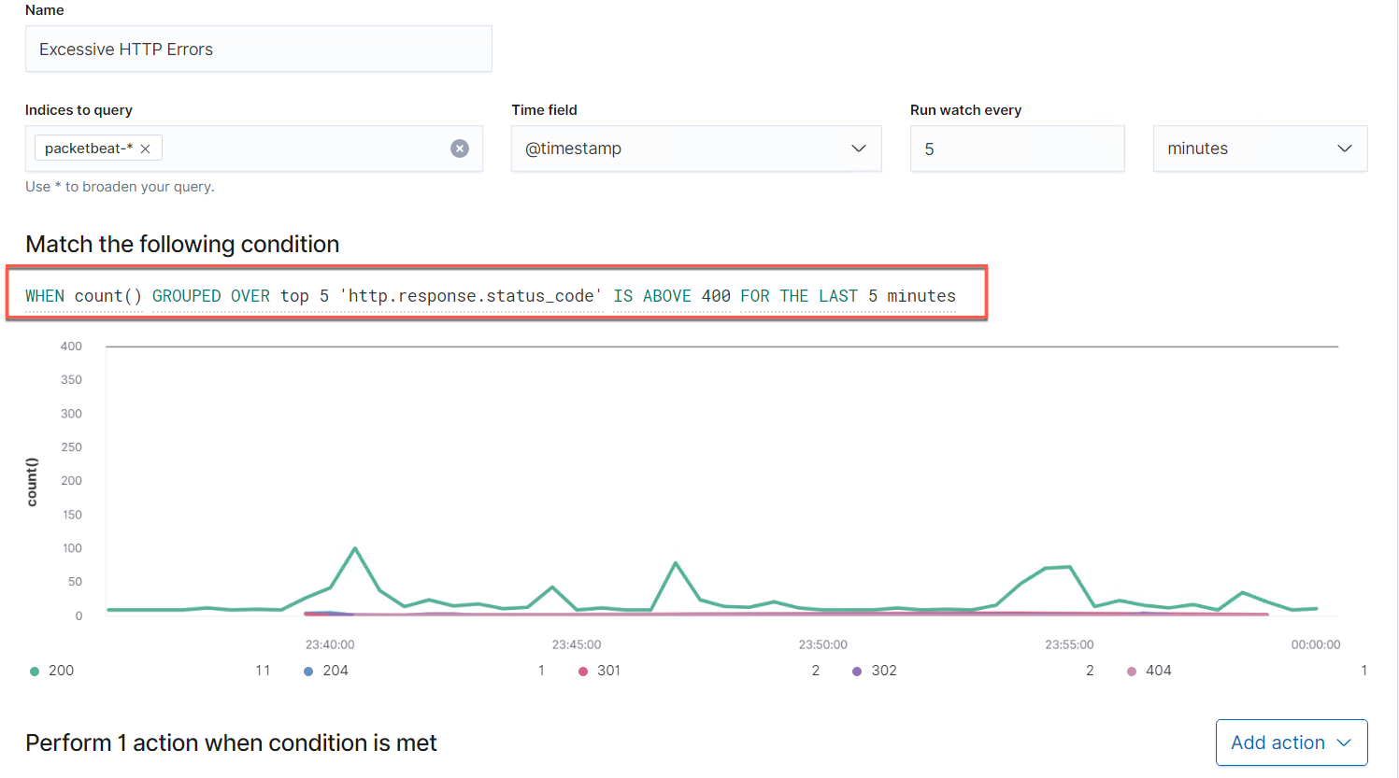
Excessive HTTP Errors
This alert monitors the Packetbeat
Threshold set if it fires more than 400 times in a 5 minute span
Notes:
Metric: packetbeat
Threshold: When a HTTP Status Code (i.e. 200-204-30-302-404) fires more than 400 times in a 5 minute span
Vulnerability Mitigated: Bad Request
Reliability: TODO: Does this alert generate lots of false positives/false negatives? Rate as low, medium, or high reliability.

Slide 12
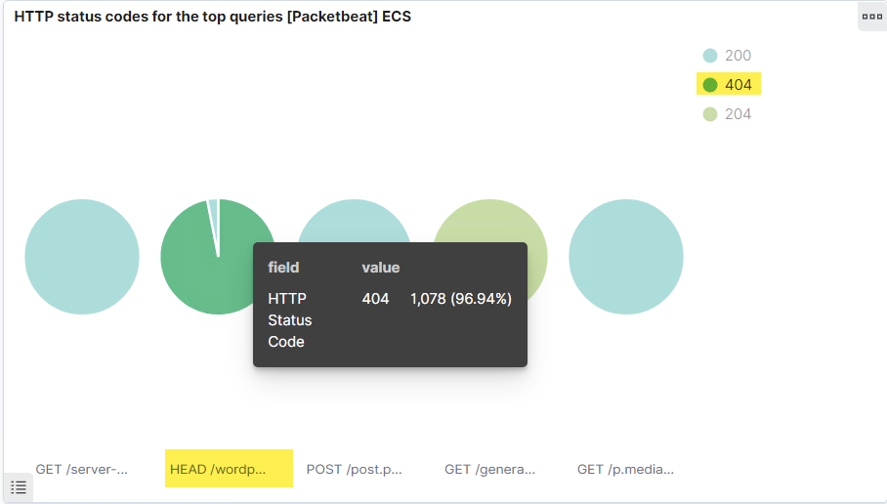
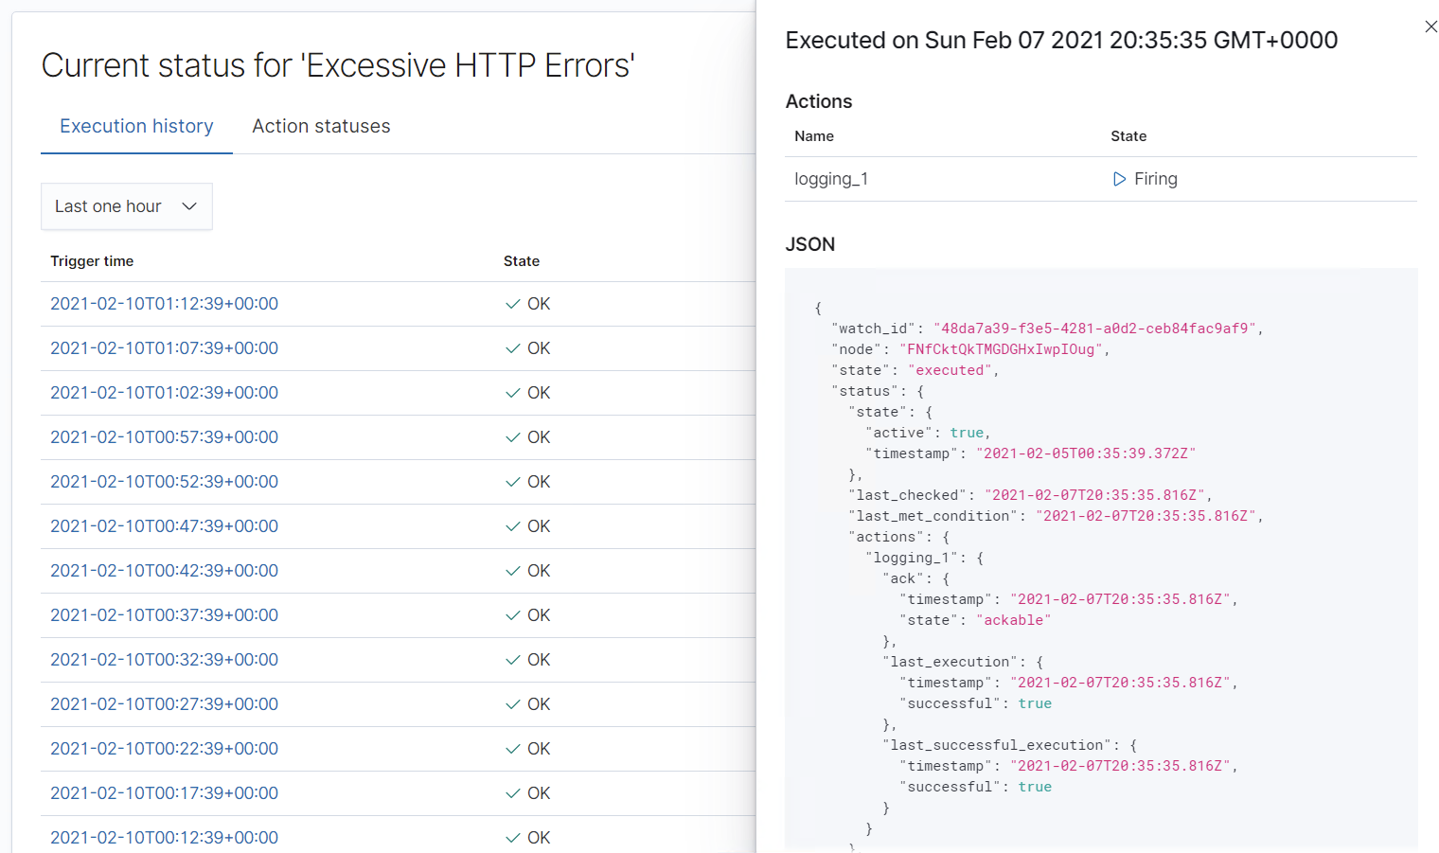
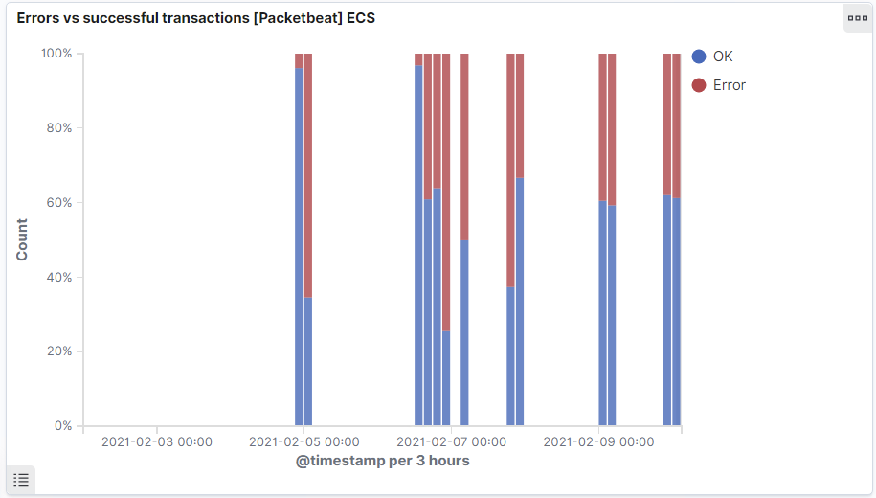
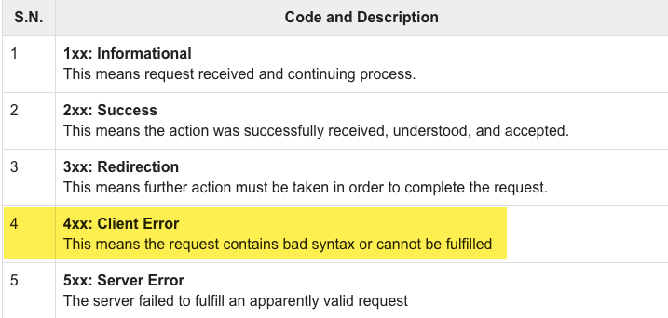
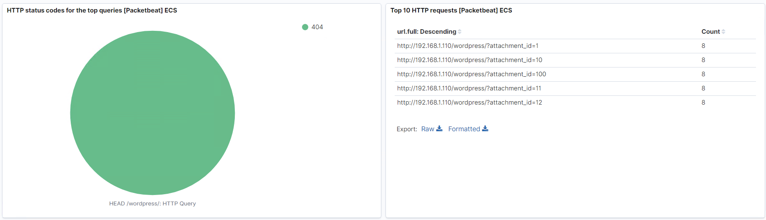
HTTP Error Monitoring

Slide 13
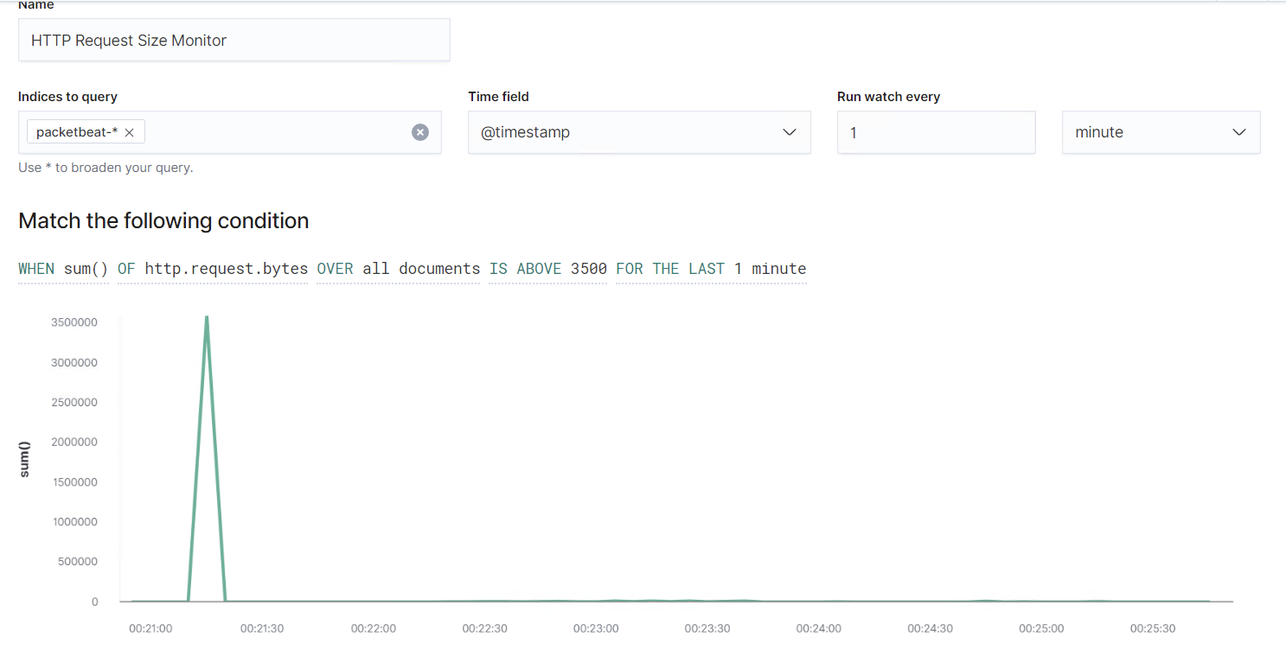
HTTP Request Size Monitor
This alert monitors packetbeat
This alert fires when the sum of bytes of any document is above 3500 in the last minute
Notes:
HTTP Request Size Monitor
HTTP Request Size Monitor is implemented as follows:
Metric: packetbeat
Threshold: When the sum of bytes for any document is above 3500 in the last 1 minute
Vulnerability Mitigated: HTTP Request Smuggling
Reliability: Does this alert generate lots of false positives/false negatives? Rate as low, medium, or high reliability. Reliability is high on this one. We also observe that our monitor is a state of “firing” for the majority of the 1 minute windows that are measured.

Slide 14
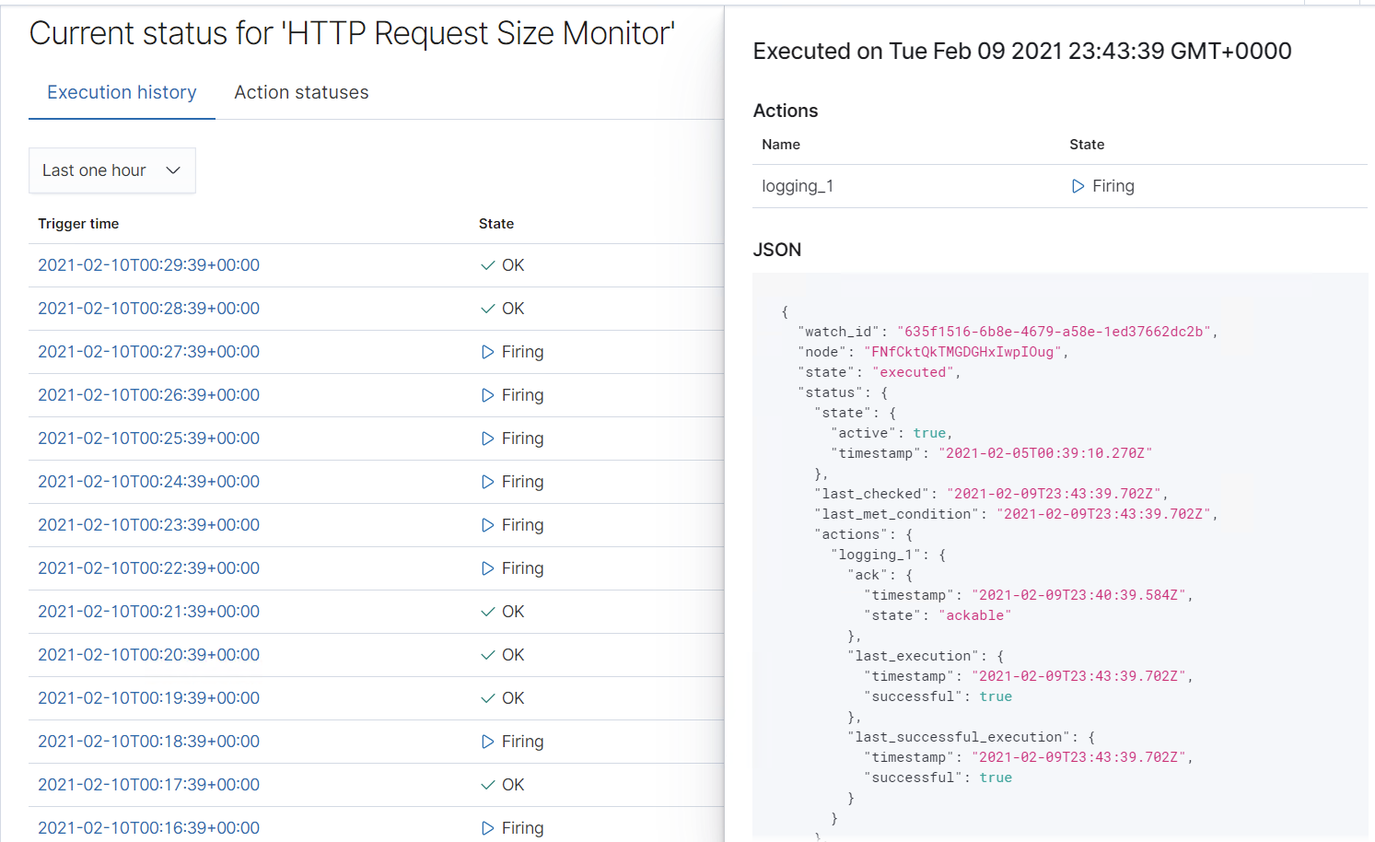
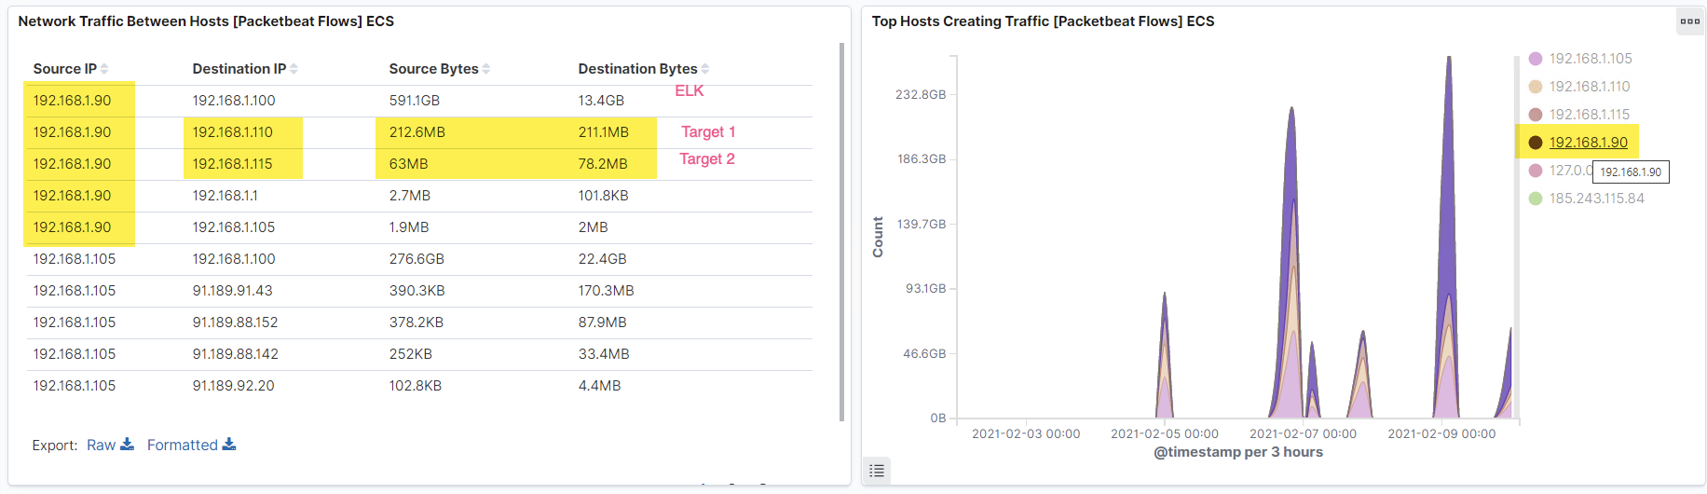
HTTP Size Monitoring

Slide 15
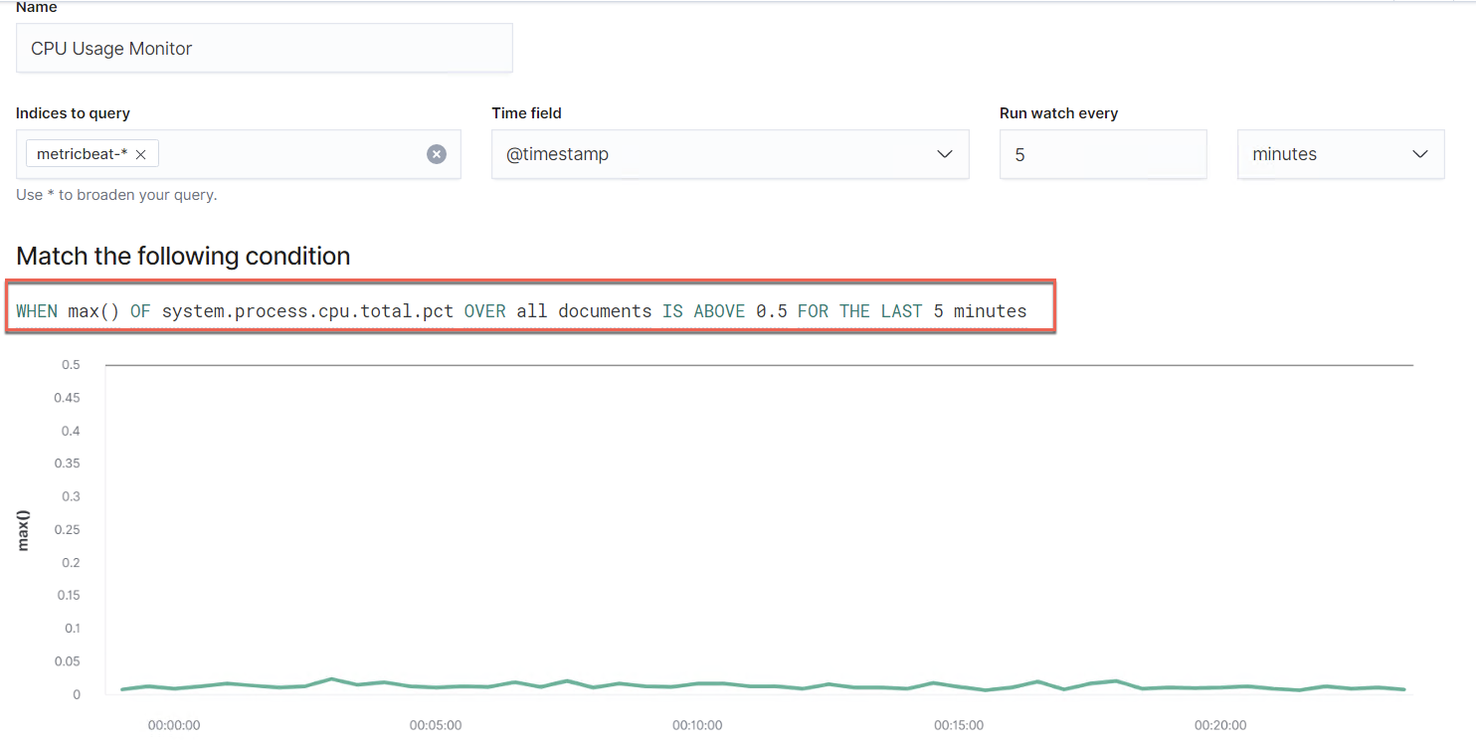
Cpu Usage Monitor
This alert monitors metricbeat
This threshold fires when the max of any system process is above 0.5 in the last 5 minutes.
Notes:
CPU Usage Monitor is implemented as follows:
Metric: metricbeat
Threshold: When the max of any system process is above 0.5 in the last 5 minutes
Vulnerability Mitigated: Monitors the cpu usage of the webserver to determine if it is under a Distributed denial of service attack (DDos)
Reliability: TODO: Does this alert generate lots of false positives/false negatives? Rate as low, medium, or high reliability. There’s no false positives/false negatives. The reason might be that the threshold is too high. The recommendation would be to set the threshold lower at .2 or .25

Slide 16
Hardening
‹#›

Slide 17
Hardening Against Excessive HTTP Errors on Target 1
Thorough application backup of system and Database before attempting any fixes.
Set up special-security-package to the latest version.
Special-security-package scans the system for viruses every day.
To install it: apt-get upgrade

Slide 18
Hardening Against Apache HTTP on Target 1
This Apache attack can be considered a slow HTTP Denial of Service attack utilizing the allowable connections. Due to there being so much data, the attackers opted to send it slowly. One way to mitigate this is by :
Configure our ELK machine with docker that hold our Ansible playbooks to include but not limited to:
setting timeouts mod_reqtimeout
implementing controls assign different priorities to different HTTP Requests (mod_qos)
Implement a WAF to and set specific rules to block specific requests. mod_Security
apt-get install mod _reqtimeout mod_qos, mod_security,
Notes:
mod_qos: module quality of service
mod_security protects websites from various attacks such as PHP and SQL injection attacks, cross-site scripting, path traversal attacks
Also, it allows for real-time analysis and HTTP traffic monitoring with little or no changes of the existing Apache configuration.

Slide 19
Hardening Against Cpu Usage on Target 1
Update the operating system
Check for firmware updates.
Update the browser.
Update other software
Set the system to consistently scan for malware.
Identify and End all the processes that are causing the Cpu to spike.
Identify the Ip that might be the root cause of the spike and blacklist it.
Always have an antivirus active and running.
Doing this make the system less vulnerable to attacks.

Slide 20
Hardening Against phpmailer on Target 2
Turn on the UseCanonicalName directive. With UseCanonicalName On Apache httpd will use the hostname and port specified in the ServerName directive to construct the canonical name for the server, and the attacker won't be able to inject code anymore.
Avoid wildcards (*) on your ServerName configuration. Using wildcards could be leveraged by an attacker to perform header injection attacks on websites and should be avoided whenever possible.
It is important to remark that depending on the environment, these configurations could impact the normal functioning of the website and should be tested on a non-production instance before hand.

Slide 21
Hardening Against Prevalent Server-Side Attacks / Target 1 & 2
Mitigation Include but not limited to:
Input sanitation: the process by which the web application (server side) actively modifies user input to an acceptable format or blocks the user’s request
Input validation: the process that checks if a user’s input is in an acceptable format
Restricted numeric range
Restricted character sequence and patterns
Restricted use of Null
Restricted parameter use of unused form fields
Content Security Policy (CSP): Detects and mitigates specific types of attacks including XSS and various other injection attacks (Not all browsers support CSP)
Ensure that all files and folders on the local server have proper access controls in place
Instituting a quality assurance program that verifies that web developers are not storing private sensitive information in the web root directory ((i.e. Lock down intellectual property, like DevOps code)

Slide 22
Hardening Against Unauthorized SSH Access on Target 1 & 2
We will harden SSH access by editing the sshd configuration file:
Change the default TCP port where SSH daemon is listening. An example is changing it from port 22 to something much higher like 24596. We want to ensure we do not use a port number that is easy to guess, such as 222, 2222 or 22222
Use SSH key pairs for authentication to enable passwordless SSH login. It is safer and also allows logging in without the need to use a password which is faster and more convenient.
Disable password-based logins on the server. This eliminates the possibility of passwords getting cracked and used for login.
Disable root access to the server and utilize a service account with the su -command to switch to a root user once properly authenticated and logged in.
We can restrict access to certain IP addresses or hostnames via TCP wrappers and editing the /etc/hosts.allow and etc/hosts.deny files.

Slide 23
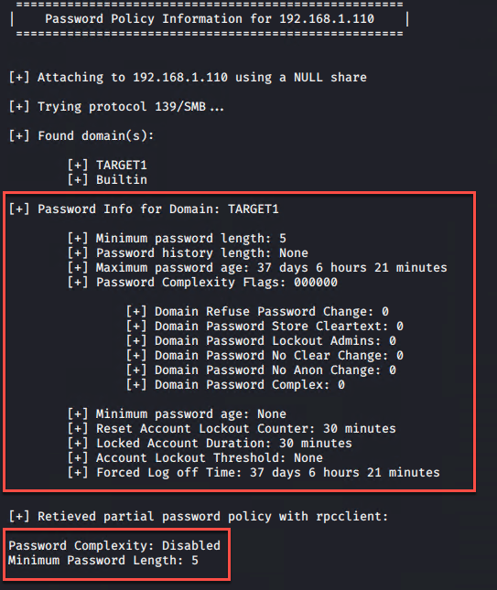
Hardening Against Weak Passwords on Target 1

Slide 24
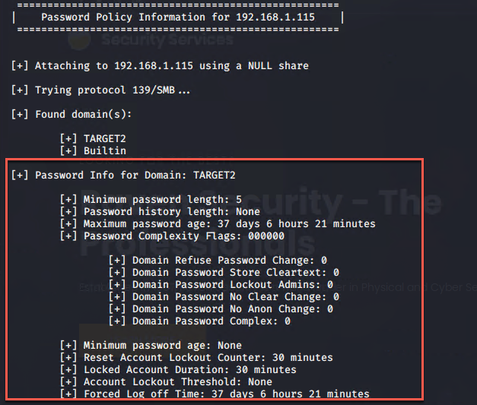
Hardening Against Weak Passwords on Target 2

Slide 25
Hardening Against Weak Passwords on Target 1 & 2
Make the password expire after a set time, so users will have to reset it
We can also set the length, number and character requirements for the password:
Tools: (1) the command “chage” (to change when a password expires (2) the command “nano” (to edit the settings inside the /etc/security/pwquality.conf file)
Recommendation(s)
Set the maximum number of days between password changes to 90
Require passwords to have a minimum of 16 x characters
Require complex passwords: 2 x numbers - 2 x upper case - lower case - 2 x special char.
Require new passwords to differ from the last 5 previous password
Limit incorrect password by setting account lockout threshold: 10 in a 10 minute time frame
Set forced log off time to 24 hours
Force immediate password expiration for all users on the server to institute new policy

Slide 26
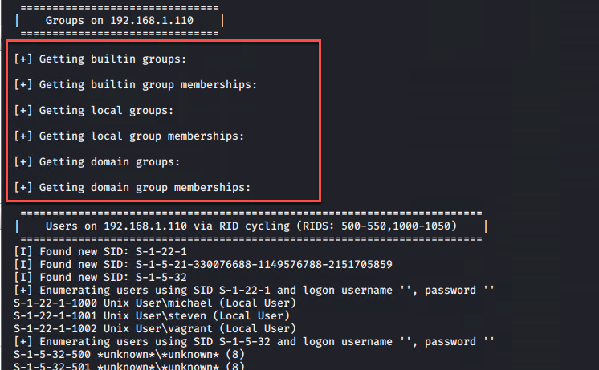
Hardening Against Escalating Privileges on Target 1 & 2

Slide 27
Hardening Against Escalating Privileges on Target 1 & 2
We will implement a strategy around practicing the principle of least privilege
We will inspect all users on the web server
check every user’s UID and GID
remove all non-admin users from having access to the server
We will create an admin group and ensure only proper admin users are assigned to this group
We will ensure that all admin users would have to employ the following in order to connect remotely to the network:
require all servers to only be accessed via 256 bit cryptographic RSA VPN
SSH key pairs for authentication
Disable root access to the server and utilize a service account
Notes:
Linux associates a specific number with each user, known as the user ID (UID).
When Linux needs to identify a user, it uses the UID, not the username
System users have a UID that is less than 1000
Standard users have a UID that is greater than 1000
The root user always has the UID of 0.

Slide 28
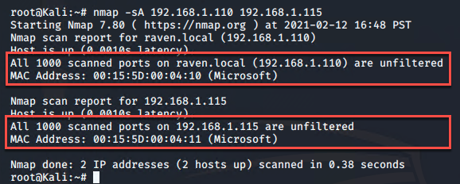
Hardening Against Unfiltered Ports on Target 1 & 2
Notes:
Target 1 (192.168.1.110) / scan revealed that all 1000 scanned ports on raven.local are unfiltered which means there is likely no firewall or filter blocking access to those scanned ports
Target 2 (192.168.1.115) / scan revealed that all 1000 scanned ports on raven.local are unfiltered which means there is likely no firewall or filter blocking access to those scanned ports
With this information, I know that I do not need to perform source routing in order to bypass the firewall’s security controls
Source routing allows attackers to craft packets that specify the route the packet must take through a network

Slide 29
Hardening Against Unfiltered Ports on Target 1 & 2
We will implement a cloud based web application firewall which is a technical security control that would be placed in front of the target 1 and 2 apache web servers to block malicious internet traffic from entering the network. Thus providing the ability to:
Low cost, subscription based, turnkey product that requires minimal resources.
Protects applications across a variety of hosting locations that protect against application layer attacks.
Cloud service providers use the most current threat intelligence to help identify and block new application security threats.
We will implement a “Hybrid” model to analyze and filter traffic based on combination of both allow (whitelisting) and deny (blacklisting) lists.
Consideration for WAF such as Wafw00f
Notes:
Target a firewalld type because it would not require the disruption of services when implementing new services
Uses zones to divide network interfaces into groups of shared trust level.
Zones are assigned set of rules depending on the needs and restrictions of each zones interface
If company resources allow:
Would implement a IDS or IPS system
What's the difference between an IDS and an IPS?
Answer: An Intrusion Detection System (IDS) is passive and only logs a threat for future analysis. They do not respond to attacks. In contrast, an Intrusion Prevention System (IPS) is active and will automatically take action by logging and blocking a threat.

Slide 30
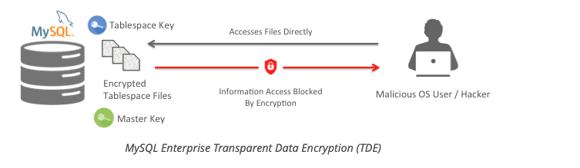
Hardening Unsecure MySQL Database on Target 1 & 2
MySQL Enterprise Transparent Data Encryption (TDE) protects your critical data by enabling data-at-rest encryption in the database. It protects the privacy of your information, prevents data breaches and helps meet regulatory requirements including:
Payment Card Industry Data Security Standard (PCI DSS)
Health Insurance Portability and Accountability Act (HIPAA)
General Data Protection Regulation (GDPR)
California Consumer Protection Act (CCPA)
And more

Slide 31
Implementing Patches
‹#›

Slide 32
Implementing Patches with Ansible
Playbook Overview
Explain which vulnerability each task in the playbook patches.
We will implement provisioners to run the tasks. The tasks performed will:
Update browser
Upgrade security package to newer version
Block specific request
Automatically conduct service updates
Implement quality of service controls (i.e.)
prioritizing what information will be collected
set timeout thresholds
Notes:
timeout thresholds mean if data is not received with in an allotted time frame
26. What are the individual components of microservices called?
The individual components of a microservice are:
- A front-end server
- A back-end server
- A database
27. What is a service that writes to a database and communicates to other services? A back-end server writes to a database and communicates to other services
28. What type of underlying technology allows for microservices to become scalable and have redundancy?
Microservices are built with “container” technology which are lightweight virtual environments. Docker is an example of a “container” technology.
29. What tool can be used to deploy multiple containers at once?
Docker Compose is a tool that can deploy multiple containers at once and then configure them.
30. What kind of file format is required for us to deploy a container set?
Docker Compose uses YAML file format to define the containers for a deployment, their networking configuration and where you will copy files from your host machine into the container. Docker Compose also uses the same YAML file format to declare the configuration of the container.

Slide 33
Thank You! Up Next (Network Team)

